Slide 1

Object Oriented Programming Android Tutorials Tutorial #6 : Touch and multi-touch
Department of Computer Science and Information Engineering
Shuo-Han Chen (陳碩漢), shchen@csie.ntut.edu.tw
Hong-Yue Technology Research Building 1223
F 09:10 - 12:00
Notes:
Good Afternoon everyone
I am Shuo-Han Chen, a postdoctoral research fellow at Academia Sinica
It is a great honor to be invited by the department for being here today

Slide 2

Android Game Framework 使用說明
單點及多點觸控
練習 6A : 單點觸控
Notes:
Thank you for listening. Now, I would like to end today’s talk by the Q & A time.

Slide 3
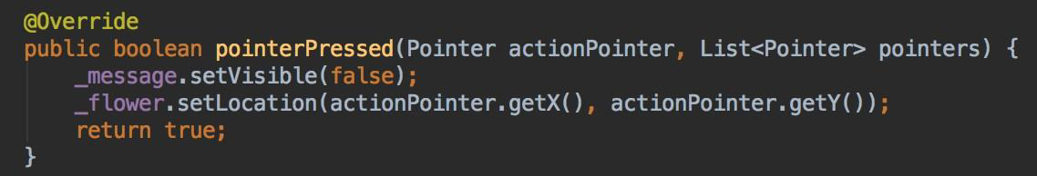
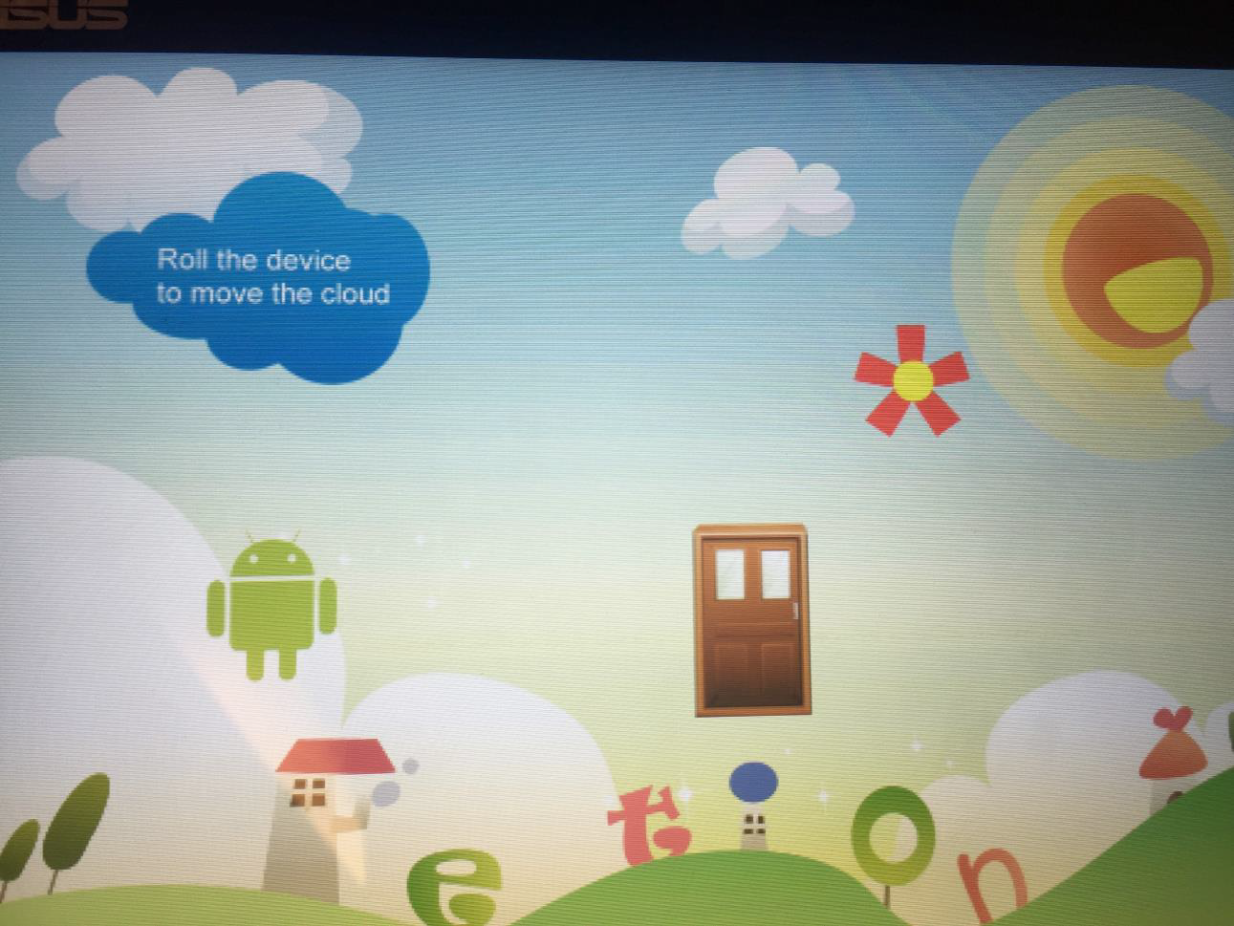
1.在 StateRun 中 pointerPressed 改成以下程式碼
2.執行， 執行結果如下(隨意觸碰螢幕)
花朵會出現在觸碰的位置上

Slide 4
Android Game Framework 使用說明
單點及多點觸控
練習 6B :多點觸控
Notes:
Thank you for listening. Now, I would like to end today’s talk by the Q & A time.

Slide 5
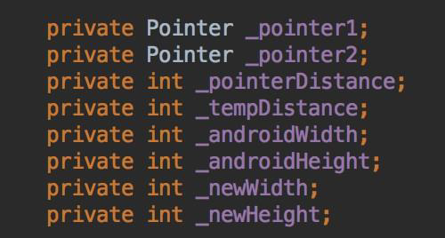
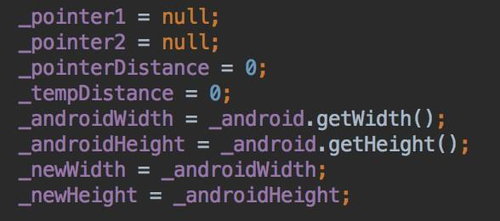
1.在 StateRun 中增加以下變數
2. initialize 加入以下程式碼使數值初始化

Slide 6
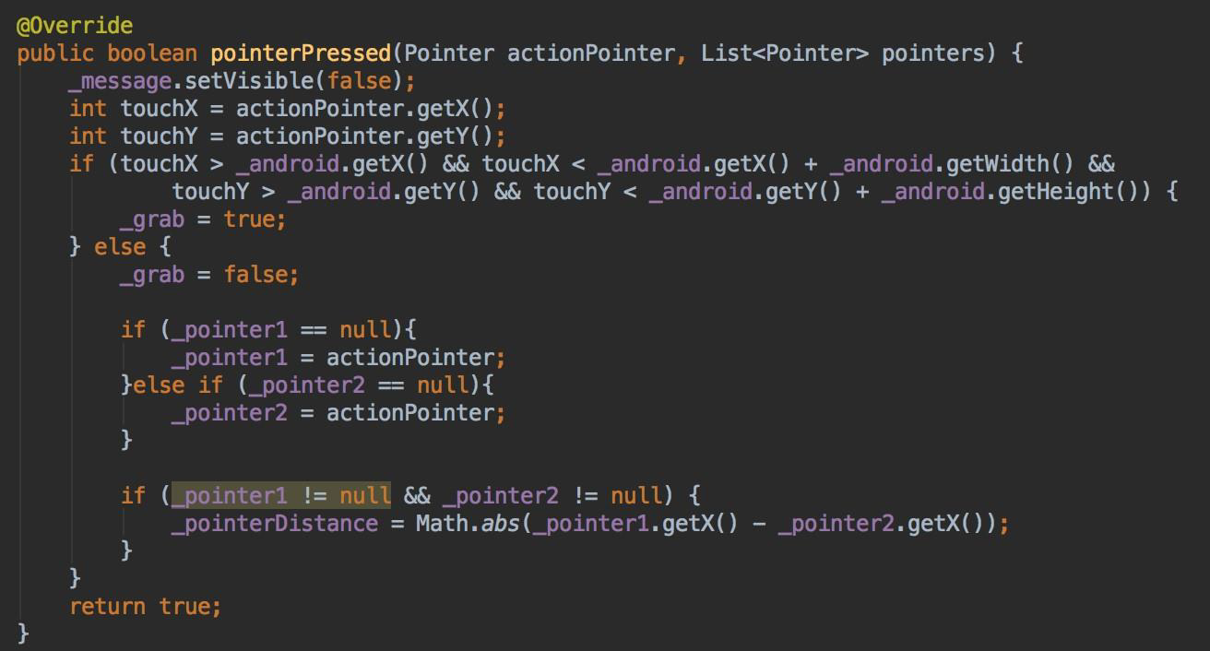
3. pointerPressed修改如 下，當螢幕被觸控時會執行此 function

Slide 7
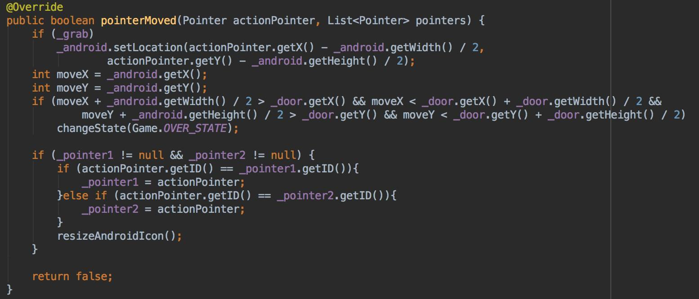
4. pointerMove修改如下，當手指在螢幕上移動或按著不放時執行此function

Slide 8
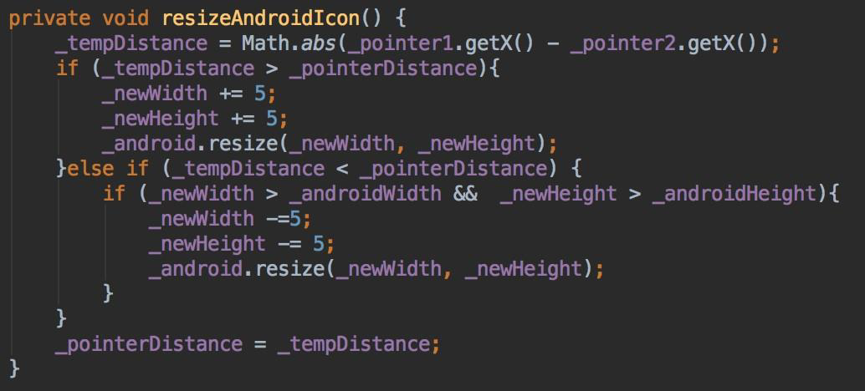
5.新增加此 function

Slide 9
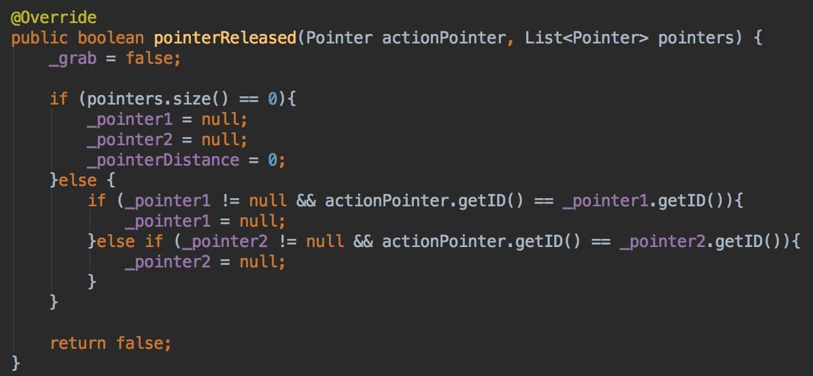
6. pointerReleased修改如下，當手指離開螢幕時執行此 function
7.執行結果(手指不碰觸到Android icon情況下，2隻手指做縮放，Android icon 會縮放)

